Slide 1
Image Translation with
Pix2Pix Conditional GAN
Amir Houshmand
https://machinelearningmastery.com/how-to-develop-a-pix2pix-gan-for-image-to-image-translation/

Slide 2
What’s Pix2Pix
The Pix2Pix model is a type of conditional GAN, or cGAN, where the generation of the output image is conditional on an input, in this case, a source image. The discriminator is provided both with a source image and the target image and must determine whether the target is a plausible transformation of the source image.

Slide 3
Pix2Pix applications
Converting black and white to color
Converting Satellite to maps
Sketch images to Product images

Slide 4
CGAN Components
A generative Model for outputting new plausible synthetic images
A Discriminator that classifies images as real or fake

Slide 5
How the model works
The discriminator Model is updated Directly
The Generator Model is updated via the discriminator model loss
The generator is also updated via L1 loss that is measured between the real (expected) image and the generated image
The two models are trained simultaneously where the generator model tries to fool the discriminator and the discriminator tries to do a good job identifying the real images from the fake ones.

Slide 6
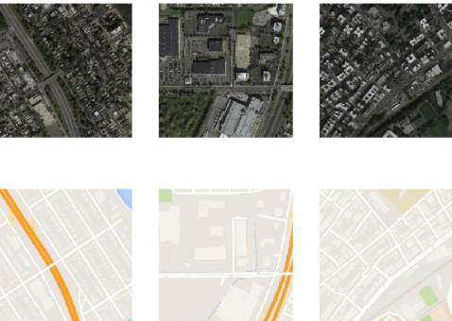
Sample translation

Slide 7
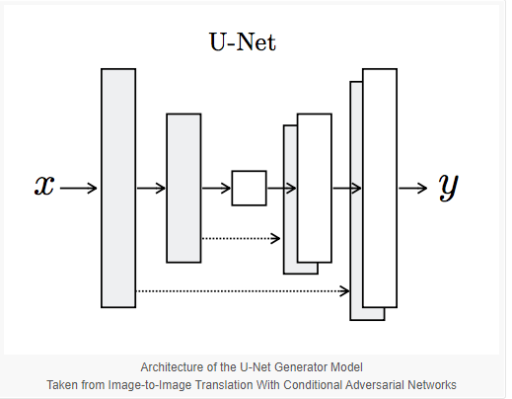
Encoder Decoder Schema

Slide 8

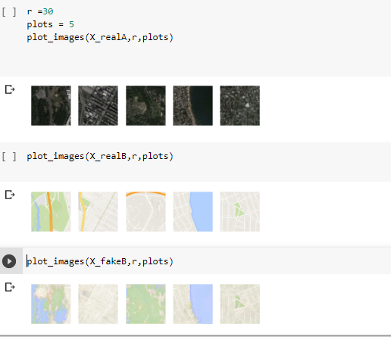
Generated images after 90 epochs

Slide 9
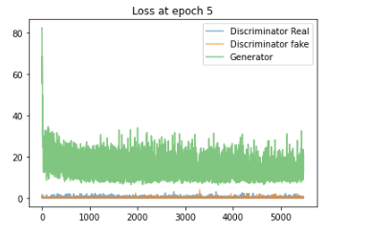
Loss

Slide 10
GITHUB link
https://github.com/mhoushma/Pic2Pix

